Slide 1
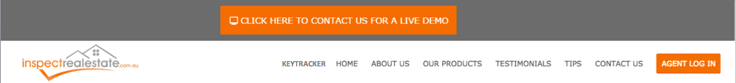
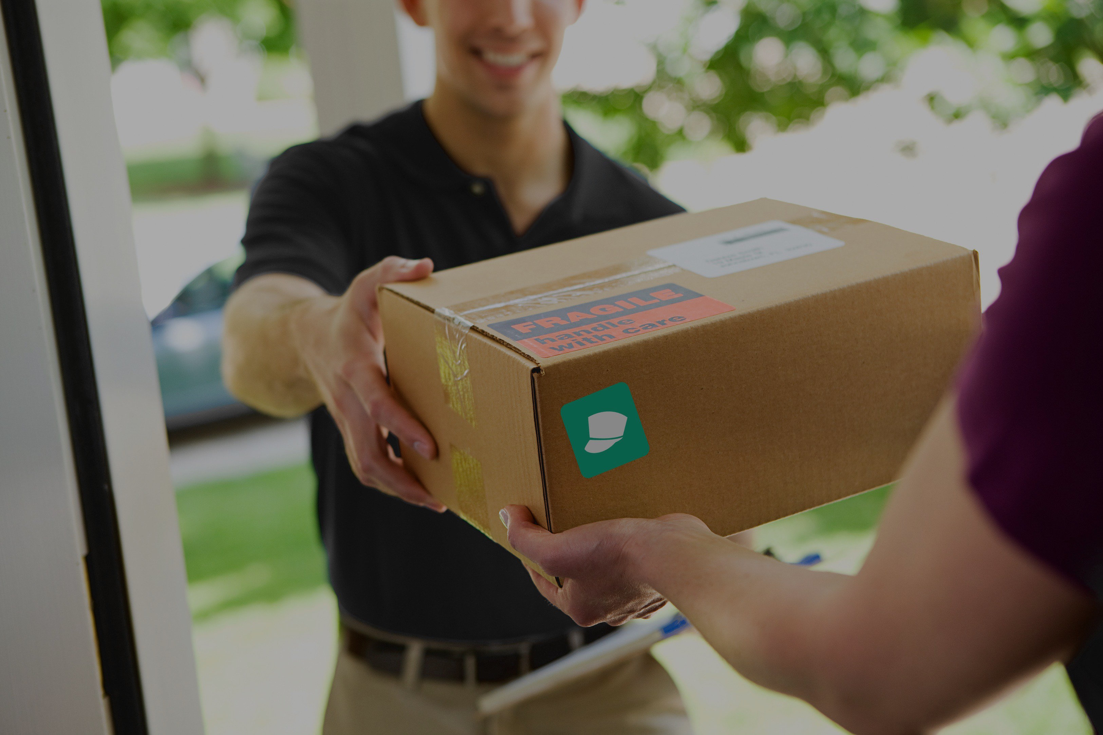
On the Spot Courier
Get your package there
START ORDERING
HOW IT WORKS
Need a hand with your package?
We offer fast, efficient and affordable package delivery solutions

Slide 2




Need a hand with your package?
We offer fast, efficient and affordable package delivery solutions
FEATURES
PRICING
SUPPORT
TESTIMONIALS
FAQ
Click one of above to learn more

Slide 3
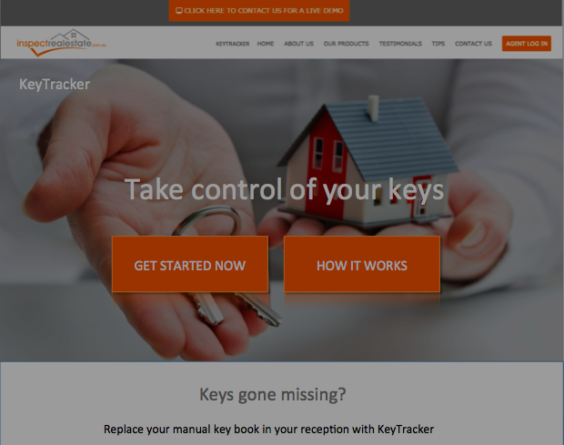

Notes:
How it works video

Slide 4
EXISTING CUSTOMER
:
NEW CUSTOMER
:
CREATE ACCOUNT
SIGN IN
CONTINUE WITHOUT ACCOUNT
CREATE NEW ORDER
CONTINUE

Slide 5

WHAT WOULD YOU LIKE TO ORDER?
DANGEROUS GOODS
SMALL PACKAGES
LARGE PACKAGES
EXCESS BAGGAGE
WHERE WOULD YOU LIKE TO SEND IT?
LOCALLY
INTER-STATE
INTER-NATIONALLY
CONTINUE

Slide 6

ORDER DETAILS
Name:
Phone Number:
Email:
Billing Address:
Post Code
Street Number
Street Name
Unit Number
City
CONTINUE

Slide 7
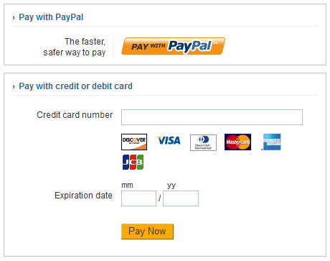
Please Enter in your Payment Details

Slide 8

Congratulations you have completed your order!
Thank you for your order!
A digital receipt has been sent to your email
GO HOME

Slide 9
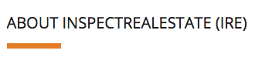

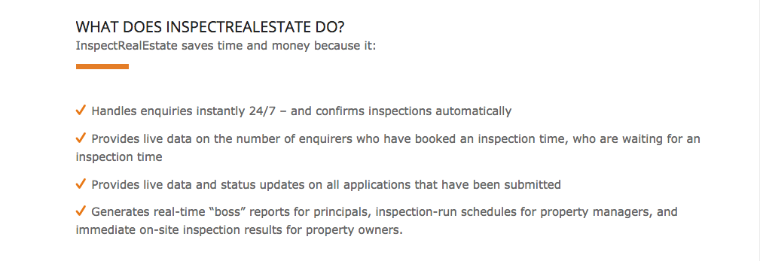

Keys gone missing?
Replace your manual key book in your reception with KeyTracker
FEATURES
PRICING
SUPPORT
TESTIMONIALS
FAQ
FEATURES
EASY ORDERING
Creating a new order has never been easier from your own home
Have your package on the way in minutes
ON-TIME GUARANTEE
✔ Never worry about when your package is getting delivered

Slide 10



PACKAGE HANDLED WITH CARE
Always know that your package will be safe and secure in our hands
CUSTOMISE ORDERS
✔ Make your order your way
✔ Choose from a variety of handling methods and package sizing options
PRIORITY SHIPPING
In a rush? We can save the day with express handling
You can be confident that your order will be there just in time!

Slide 11
Keys gone missing?
Replace your manual key book in your reception with KeyTracker
FEATURES
PRICING
SUPPORT
TESTIMONIALS
FAQ
PRICING
Pricing
SMALL PACKAGES
$10-15*
MEDIUM PACKAGES
$20-35
LARGE PACKAGES
$40+

Slide 12



Packages under 5kgs
Perfect for small items like phones, watches and other personal items!
*Depends on location
SMALL PACKAGES
$10-15*
Packages larger than 15 kgs subject to custom pricing
MEDIUM PACKAGES
$20-35
LARGE PACKAGES
$40+
Packages from 5 - 15kgs
No matter how big your package, we have to delivery system for you

Slide 13

Keys gone missing?
Replace your manual key book in your reception with KeyTracker
FEATURES
PRICING
SUPPORT
TESTIMONIALS
FAQ
SUPPORT
Support
Our support team is ready to help and easy to reach via e-mail or by filling a quick fom on the support page!

Slide 14


Support
Our support team is ready to help and easy to reach via e-mail or by filling a quick form on the support page!
Web Support
E-mail Support

Slide 15

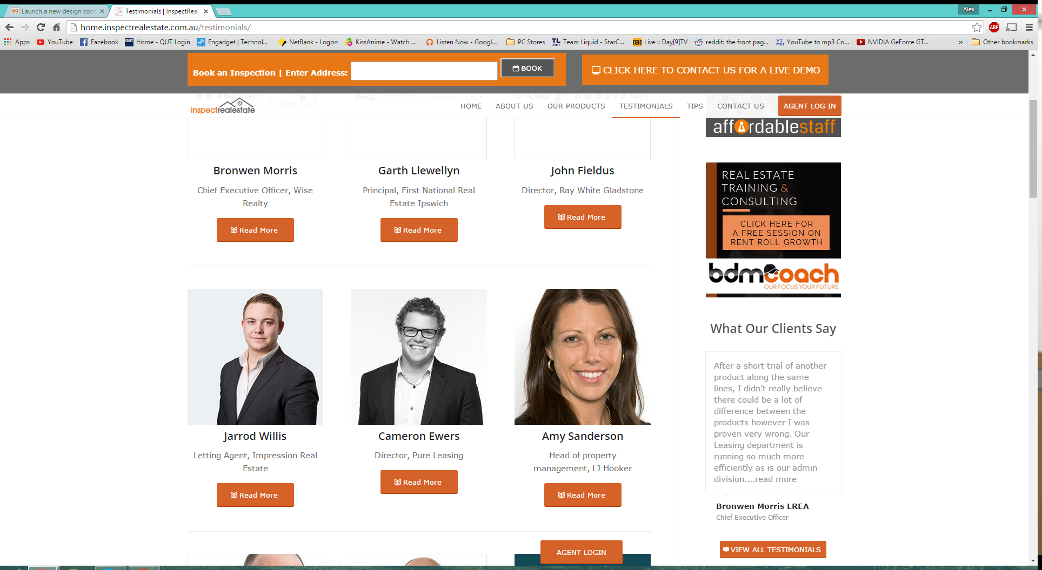
Keys gone missing?
Replace your manual key book in your reception with KeyTracker
FEATURES
PRICING
SUPPORT
TESTIMONIALS
FAQ
TESTIMONIALS
Testimonials
“The biggest technology-related improvement within the past 12 months in our office has very clearly stood out to be InspectRealEstate’s online booking system and its latest product key tracker.”

Slide 16
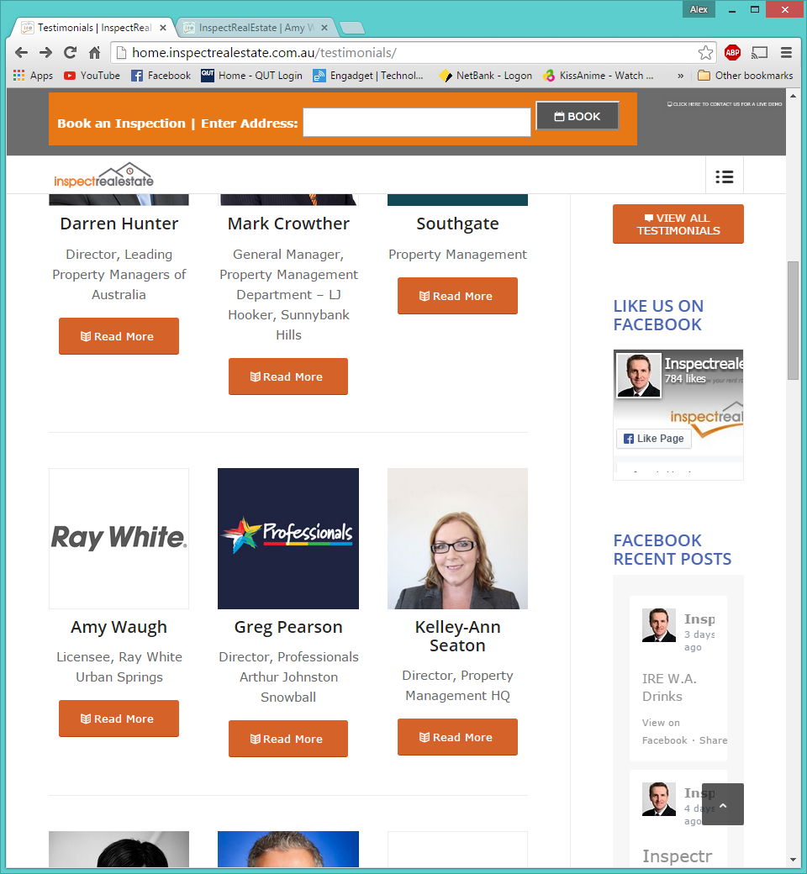
Testimonials
“The biggest technology-related improvement within the past 12 months in our office has very clearly stood out to be InspectRealEstate’s online booking system and its latest product key tracker.”
“KeyTracker is great. Our receptionist loves it and our tradespeople are really impressed with it too. They like the confirmation messages they receive when keys

Slide 17

and its latest product key tracker.”
“KeyTracker is great. Our receptionist loves it and our tradespeople are really impressed with it too. They like the confirmation messages they receive when keys are returned. It’s easy for us to track what keys are in and it saves time for everyone. We would recommend KeyTracker 100%.”

Slide 18
Keys gone missing?
Replace your manual key book in your reception with KeyTracker
FEATURES
PRICING
SUPPORT
TESTIMONIALS
FAQ
Can’t find what you’re looking for? Contact us here or visit our support page
Don’t forget to visit our library of tutorial videos which may hold the answer you seek here
How do I get started?
Can I save my orders and come back to them?
How do I make multiple orders?

Slide 19
Keys gone missing?
Replace your manual key book in your reception with KeyTracker
FEATURES
PRICING
SUPPORT
TESTIMONIALS
FAQ
FAQ
Can’t find what you’re looking for? contact us here or visit our support page
Don’t forget to visit our library of tutorial videos which may hold the answer you seek here
How do I get started?
You can get started straight away using our super simple ordering system which you can access here. Just pick what you would like, how you would like it sent to you and we will have it to your in no time!
Click “How it works” on our home page for more information on how to get started.
Is my device supported?

Slide 20
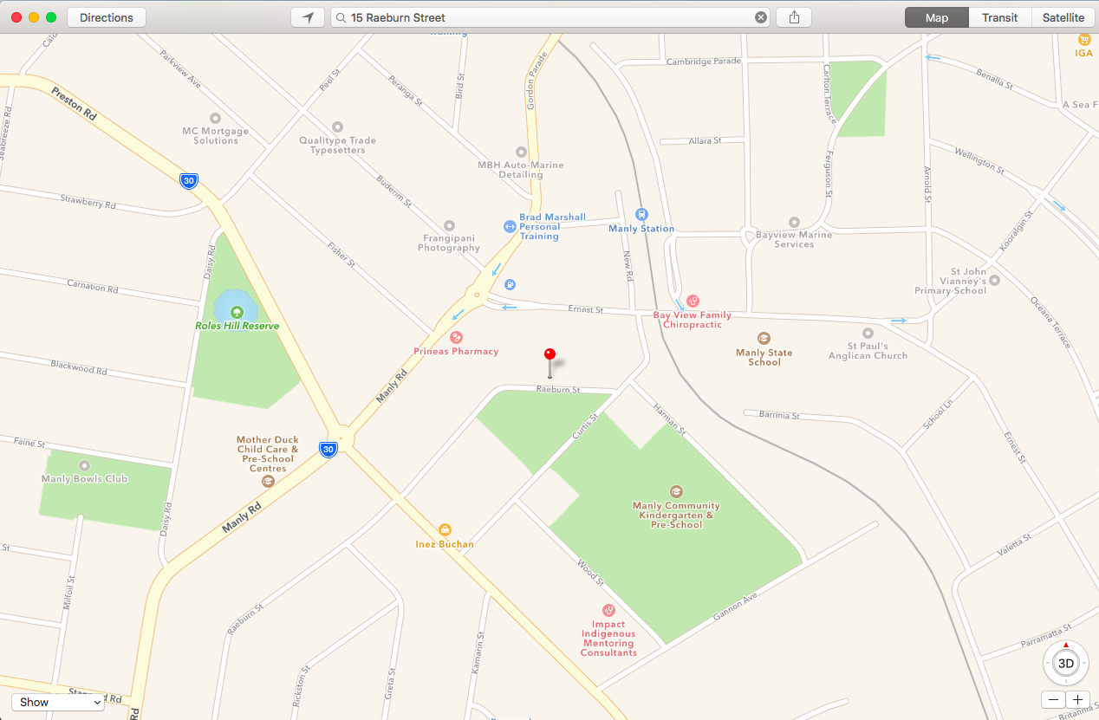
Delivery Schedule
:
Completed Orders
:
Order information
Customer information
Driver Hub
:
Roster Information
Work Email
Individual KPI Statistics
CONTINUE

